Slide 1

Customer Shopping Behavior Analysis
Uncovering insights from 3,900 purchases to guide strategic business decisions.

Slide 2

Project Overview & Goals
Analyze Behavior
Optimize Operations
Enhance Strategy
Understand spending patterns, segments, preferences.
Guide decisions on products, marketing, and subscriptions.
Future-proof business with data-driven insights.

Slide 3

Dataset Summary
Rows: 3,900
Columns: 18
Key Features:
Missing Data: 37 values in Review Rating
Customer demographics (Age, Gender, Location, Subscription)
Purchase details (Item, Category, Amount, Season, Size, Color)
Shopping behavior (Discount, Promo, Previous Purchases, Frequency, Review, Shipping)

Slide 4
Exploratory Data Analysis (Python)
01
02
03
Data Preparation
Missing Data Handling
Feature Engineering
Loading, initial exploration (df.info(), .describe()).
Imputed Review Rating with median by category.
Created age_group and purchase_frequency_days.
04
05
Data Consistency
Database Integration
Dropped redundant promo_code_used column.
Loaded cleaned data to PostgreSQL for SQL analysis.

Slide 5
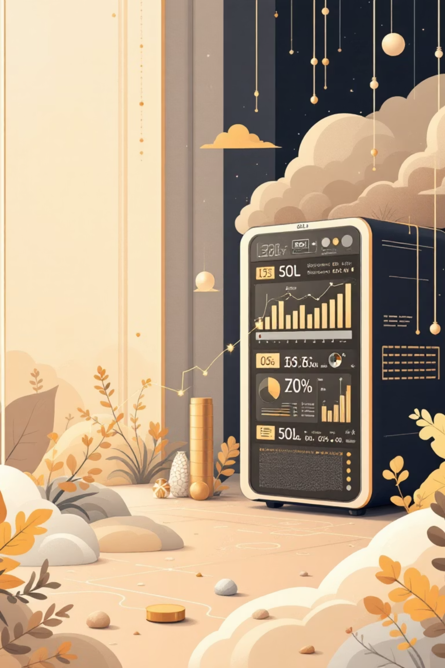
SQL Analysis: Key Business Insights
1
Revenue by Gender
Male: $157,890, Female: $75,191
2
High-Spending Discount Users
839 customers identified.
3
Top 5 Products by Rating
Gloves (3.86), Sandals (3.84), Boots (3.82), Hat (3.80), Skirt (3.78)
4
Shipping Type Comparison
Express: $60.48 avg, Standard: $58.46 avg

Slide 6
SQL Analysis: Subscription & Discounts
Subscribers vs. Non-Subscribers
Discount-Dependent Products
Top 5 with highest discount rate:
Yes
1053
$59.49
$62,645
Hat (50%)
No
2847
$59.87
$170,436
Sneakers (49.66%)
Coat (49.07%)
Sweater (48.17%)
Pants (47.37%)

Slide 7
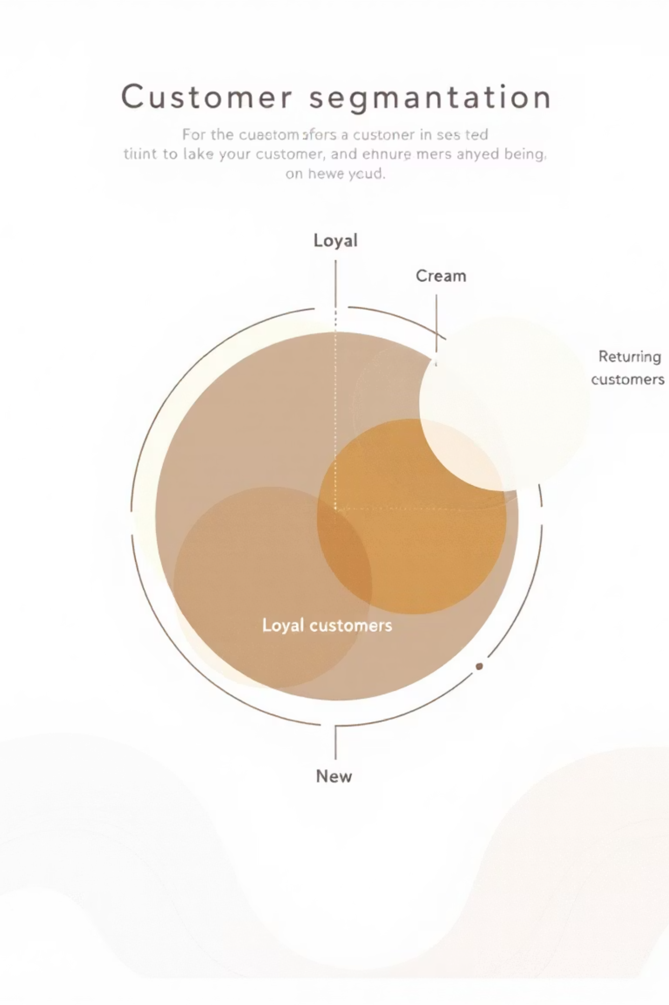



SQL Analysis: Customer Segmentation
Loyal
3116 Customers
Returning
701 Customers
New
83 Customers

Slide 8

SQL Analysis: Product & Age Insights
Top 3 Products per Category
Revenue by Age Group
Accessories: Jewelry, Sunglasses, Belt
Young Adult: $62,143
Clothing: Blouse, Pants, Shirt
Middle-aged: $59,197
Footwear: Sandals, Shoes, Sneakers
Adult: $55,978
Outerwear: Jacket, Coat
Senior: $55,763

Slide 9
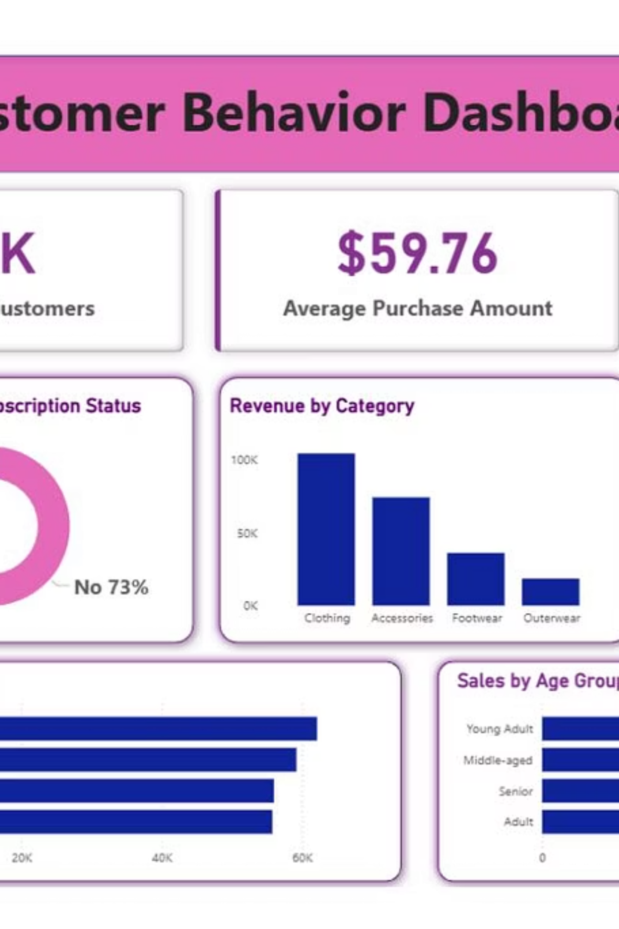
Power BI Dashboard
Interactive visualization of all key insights.
A comprehensive view for data-driven decision making.

Slide 10

Business Recommendations
Boost Subscriptions
Promote exclusive benefits to increase sign-ups.
Customer Loyalty Programs
Reward repeat buyers to foster loyalty.
Review Discount Policy
Balance sales with margin control for profitability.
Product Positioning
Highlight top-rated items in marketing campaigns.
Targeted Marketing
Focus on high-revenue age groups and express-shipping users.

